Slide 1
Project Title: AI Procurement Agent
Name: Pankaj Kumar
Date: 01-10-2026

Slide 2
PROBLEM STATEMENT
Procurement teams often handle a large number of repetitive activities such as purchase requests, supplier selection, quotation comparison, purchase orders, invoice verification, and procurement-policy compliance. Manual processes can lead to delays, inconsistent supplier evaluation, duplicate purchases, higher procurement costs, and difficulty tracking procurement activities.
Manual processing of purchase requests.
Time-consuming supplier and quotation comparison.
Difficulty identifying suitable suppliers quickly.
Inconsistent procurement decisions.
Risk of purchasing outside approved procurement policies.
Duplicate or unnecessary purchase requests.
Delays in purchase-order creation and approval.
Difficulty tracking supplier performance and spending.
Manual invoice and purchase-order matching.
Limited real-time visibility into procurement operations.

Slide 3
PROJECT OVERVIEW
The AI Procurement Agent is an agentic AI system designed to automate the procurement lifecycle from purchase request to supplier selection, approval, purchase order, and invoice verification.
An employee or department can submit a request such as:
"We need 20 laptops with at least 16 GB RAM and 512 GB SSD for the new employees.“
The AI agent understands the requirement, extracts important specifications, checks existing inventory, searches approved suppliers, retrieves quotations, compares price and delivery terms, checks procurement policies, and prepares a recommendation.
For high-value purchases or decisions requiring authorization, the agent sends the case to a procurement manager for human approval rather than making the final decision autonomously.

Slide 4
STAKEHOLDER’S REQUIREMENTS
Procurement Team: Receive and process purchase requests; Compare supplier quotations; Search approved suppliers; Monitor purchase orders; Track supplier performance; Reduce manual procurement activities; Ensure procurement-policy compliance.
Department Managers: Submit purchase requests; Track request status; Approve purchases within their authorization limits; Monitor departmental spending.
Employees: Submit purchase requirements using natural language; Check request status; Receive updates about approvals and orders; Avoid complicated procurement forms where possible.
Suppliers: Receive quotation requests; Submit quotations; Provide pricing and delivery information; Receive purchase orders; Update order status.
Finance Team: Verify purchase orders and invoices; Monitor procurement spending; Perform invoice matching; Track payments; Identify discrepancies.
Procurement Management: Monitor procurement KPIs; Analyze supplier performance; Monitor procurement costs; Identify cost-saving opportunities; Ensure compliance with procurement policies.
IT / Security Team: Secure procurement data; Manage user authentication and authorization; Maintain audit logs; Control access to supplier and financial information; Monitor AI-agent activities.

Slide 5
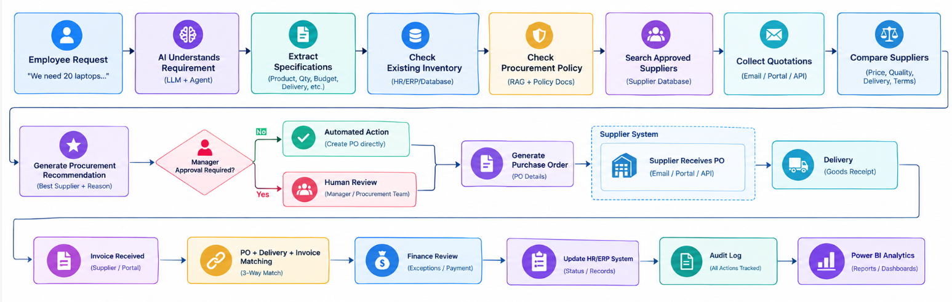
SOLUTION ARCHITECTURE
The AI Procurement Agent automates the procurement process from understanding an employee’s purchase request to supplier comparison, approval, and purchase-order generation.
It also verifies deliveries and invoices by matching purchase orders, helping identify discrepancies before finance processing.
Finally, procurement activities are recorded in audit logs and analyzed through Power BI for better visibility, compliance, and decision-making.

Slide 6
TECHNOLOGY STACK
⚙️ Automation & Workflow
N8n Cloud
N8n AI Agent
Webhooks / Manual Trigger
🤖 AI & LLM
Groq
AI Agents
Prompt Engineering
📂 Data
Microsoft Excel
Google Drive
Extract from file
Convert to file
🔍 Procurement & Decision Processing
IF / Conditional Logic
Merge Nodes
Human Approval
📊 Reporting & Audit
Audit Log.xlsx
Structured JSON

Slide 7
INPUT DATA & FILES
Employee Requests – Contains employee details, requested items, quantity, required date, and justification.
Inventory – Provides available products, stock quantities, and item information.
Suppliers – Defines approval requirements based on purchase value, category, or department.
Supplier Quotations – Contains supplier prices, delivery timelines, quantities, and commercial terms.
Procurement Policy – Includes purchasing rules, spending limits, supplier requirements, and approval guidelines.
Purpose – These inputs help the AI Agent validate requests, compare suppliers, and prepare recommendations for human approval.

Slide 8
AI REQUIREMENT UNDERSTANDING
Analyzes employee procurement requests using an AI Agent.
Converts natural-language requests into structured procurement requirements.
Identifies item name, category, quantity, specifications, and required date.
Extracts budget, priority, and business justification when available.
Detects missing or unclear information in the employee request.
Passes the structured requirement to the next steps: Inventory Check, Policy Validation, and Supplier Search.

Slide 9
INVENTORY & PROCUREMENT POLICY CHECK
Checks the current inventory to determine whether the requested item is already available.
Compares the requested quantity with the available stock.
Validates the request against the organization’s procurement policies and rules.
Checks conditions such as purchase limits, approval requirements, and eligible procurement categories.
Identifies whether the request can be fulfilled from inventory or requires external purchasing.
Sends valid requests to the Approved Supplier Search and Quotation Collection stages for further processing.

Slide 10
APPROVED SUPPLIER SEARCH
Searches the approved supplier list based on the requested item and category.
Filters suppliers according to the organization’s procurement rules and eligibility criteria.
Retrieves relevant supplier names, products, prices, and availability where available.
Matches supplier offerings with the required specifications and quantity.
Identifies suitable suppliers for the quotation collection stage.
Ensures procurement is considered only from authorized and approved suppliers.

Slide 11
QUOTATION COLLECTION & SUPPLIER COMPARISON
Collects supplier quotations for the required item and quantity.
Captures key details such as price, delivery time, quantity, and supplier terms.
Compares quotations from multiple approved suppliers.
Evaluates suppliers based on cost, delivery timeline, product specifications, and other requirements.
Identifies the differences between available supplier options.
Provides a structured comparison to support the procurement recommendation and human approval.

Slide 12
TESTING & SAMPLE RESULTS
Tested the AI Procurement Agent using sample employee procurement requests.
Verified the AI’s ability to understand requirements and extract key specifications.
Tested inventory availability and procurement policy validation using the provided Excel and policy files.
Validated the approved supplier search and quotation collection process.
Compared supplier quotations based on price, specifications, and delivery time.
Confirmed that the workflow generates a structured procurement recommendation for human approval.

Slide 13
BUSINESS BENEFITS
Reduced Procurement Processing Time: Automates repetitive activities such as request processing, supplier search, quotation comparison, and document preparation.
Improved Procurement Efficiency: Procurement teams can spend less time collecting and organizing information and more time managing suppliers and procurement strategy.
Better Supplier Visibility: The system can consolidate supplier information, historical purchases, pricing, delivery performance, and quality metrics.
Procurement Cost Analysis: Historical procurement data can help organizations identify pricing trends, frequently purchased products, and potential cost-saving opportunities.
Policy Compliance: The agent can check purchase requests against predefined procurement rules and retrieve relevant policies through RAG.
Faster Purchase Order Processing: Once required approvals are obtained, the system can automatically prepare and route purchase-order information.
Invoice Error Detection: AI-assisted PO/invoice matching can identify discrepancies in: Quantity; Price; Supplier; Product; Tax; Payment terms
Better Supplier Management: Organizations can track: Delivery performance; Quality; Pricing; Order history; Contract status; Supplier responsiveness
Human-in-the-Loop Decision Making: High-value purchases, unusual requests, supplier exceptions, and policy-sensitive decisions can be routed to authorized procurement personnel.

Slide 14
CHALLENGES & SOLUTIONS
CHALLENGES
Employee requests may be unstructured or incomplete.
Managing and processing multiple Excel input files.
Checking inventory availability accurately.
Validating requests against procurement policies.
Finding suitable approved suppliers.
Comparing multiple supplier quotations efficiently.
SOLUTIONS
Used an AI Agent to understand requests and extract required information.
Used n8n Extract From File and Merge nodes to process Excel data.
Automated inventory availability and quantity checks.
Used the Procurement Policy as a reference for validation.
Used the Approval Matrix and supplier data to identify eligible suppliers.
Automated quotation comparison based on price, specifications, and delivery time.

Slide 15
FUTURE ENHANCEMENTS
Automated Email Integration – Automatically send procurement requests, quotations, and approval notifications through email.
Real-Time Supplier Integration – Connect with supplier APIs to retrieve real-time prices, availability, and delivery information.
Advanced Supplier Scoring – Introduce a structured scoring mechanism based on price, quality, delivery performance, and supplier reliability.
Automated Purchase Order Generation – Generate purchase orders automatically after human approval.
ERP Integration – Integrate with systems such as SAP or other ERP platforms for seamless procurement processing.
Procurement Analytics Dashboard – Build a Power BI dashboard to monitor spending, supplier performance, approval times, and procurement trends.
Human-in-the-Loop Approval – Add dedicated approval workflows for high-value or policy-sensitive purchases.

Slide 16
PROJECT OUTCOME
End-to-End AI Procurement Agent – Automated procurement workflow developed using n8n Cloud and Groq.
Requirement Understanding – AI-based extraction of employee requirements from procurement requests.
Inventory & Policy Validation – Automated checking of stock availability and procurement policy compliance.
Approved Supplier Identification – Identification of suitable suppliers based on the approval matrix.
Quotation Comparison – Structured comparison of supplier quotations based on key procurement factors.
Procurement Recommendation – AI-generated supplier recommendation prepared for human approval.
Workflow Documentation – Complete workflow architecture, testing results, user manual, and project documentation.

Slide 17
THANK YOU!

